Slide 1

A Simple Exponential time Translation from Cyclic to Inductive
Hotel Shinko, Isawa Onsen (Fuefuki, Japan)
February, 25 2026
Stefano Berardi, Ugo de’ Liguoro, Daniel Osorio
C.S. Dept., Torino University, Italy

Slide 2
Cyclic Proofs and Inductive Definitions
Cyclic proofs are a version of Martin Lof theory of inductive definitions which is particulary suitable for proof search.
They are characterized by a condition called Global Trace Condition (GTC).
Cross-checking of inductive proofs could be done by translating them into Martin Lof proofs then checking the translation by a proof assistant.
Translation implicitly requires to formalize a proof that proofs with GTC are correct.

Slide 3
Translating Cyclic Proofs into Inductive Definitions
A first translation used a formalization of Ramsey Theorem (Berardi-Tatsuta), when both systems include Peano Arithmetic.
This proved the equivalence of the two systems but can be hardly used in practice.
A second translation (Mirai) used induction on a formalization of Ranking Functions (Amram-Lee).
Computing Ranking Functions for a cyclic proof requires triple exponential time in general.

Slide 4
From Triple to Single
Exponential Time
Brotherston formalization of Cyclic proofs uses sequents as sets of formulas and non-injective colored relations. The same if we use multisets.
Using sequents as lists of formulas we switch to injective (fan-in free) colored relations.
Ranking Functions for fan-in free colored relations require double exponential time and produce a single exponential space output.
We claim the possibility of a translation in single exponential (poly-exponential) time.

Slide 5
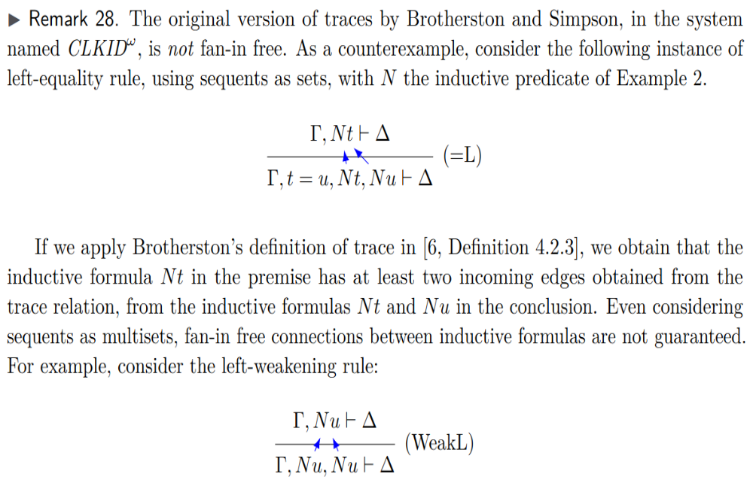
Brotherston Traces are not Injective for sets/multisets (Osorio phd)

Slide 6
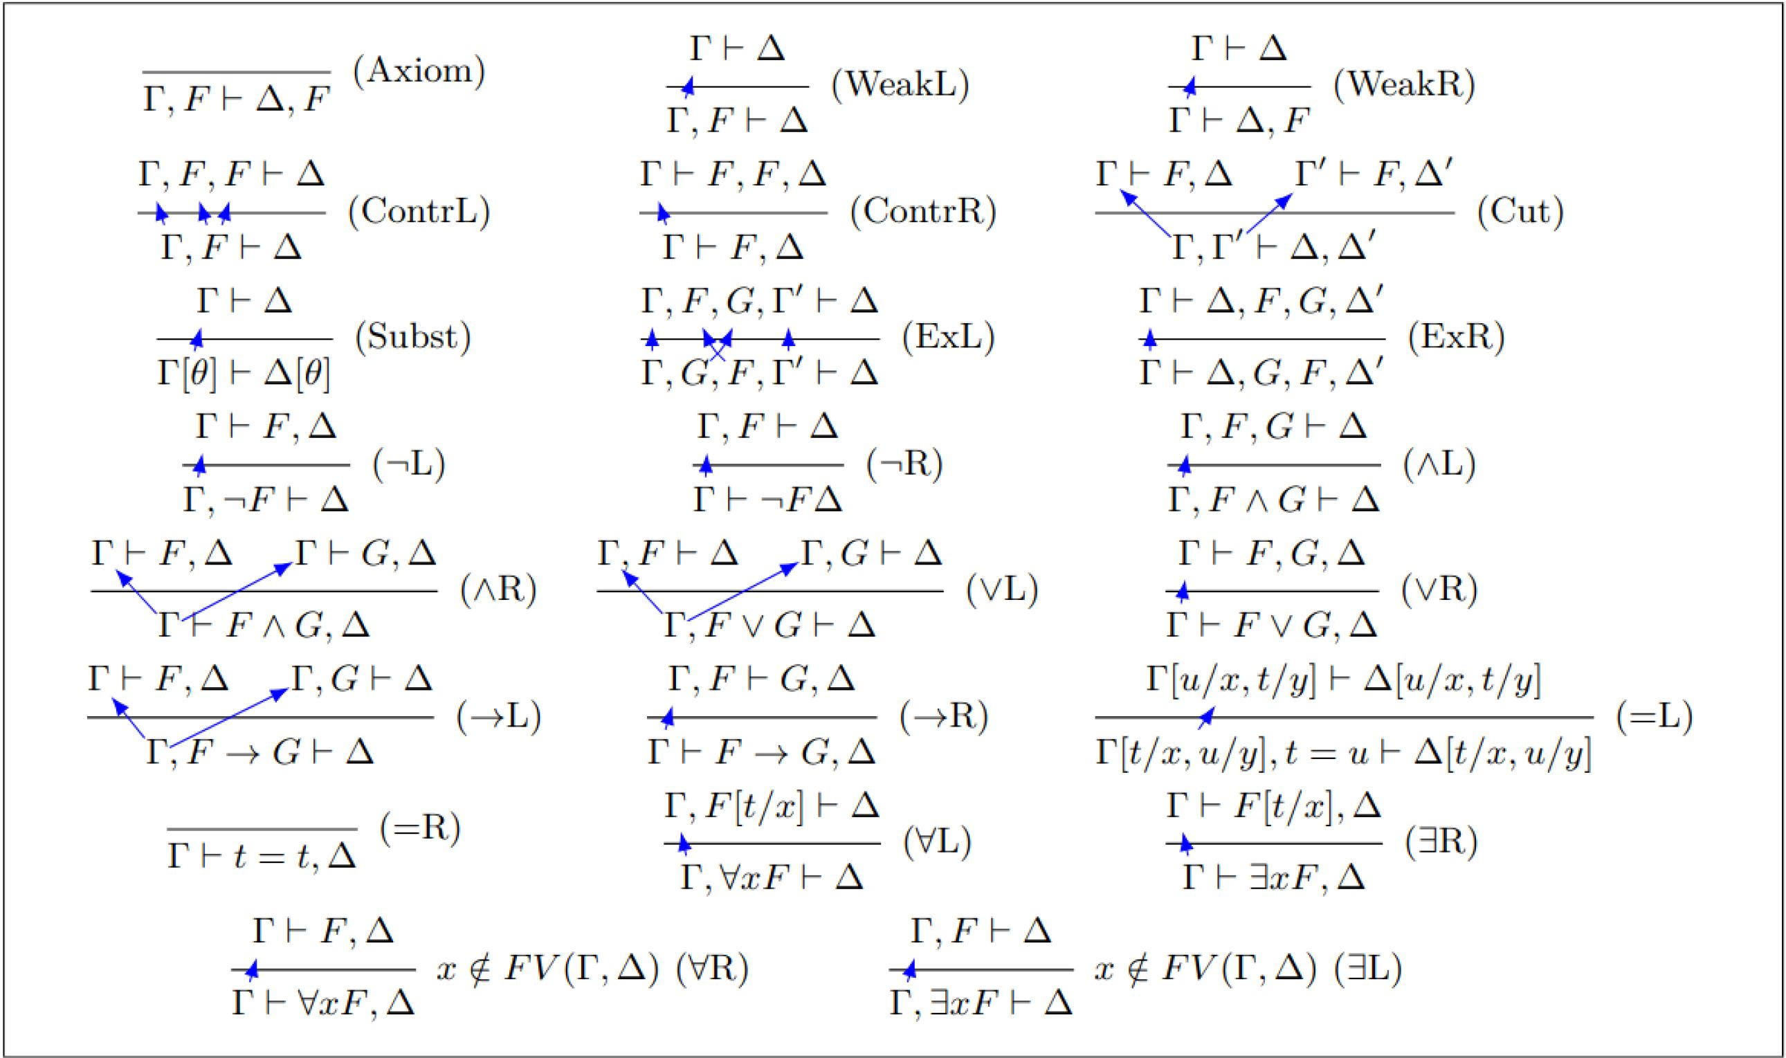
Injective Traces for Sequents as Lists

Slide 7
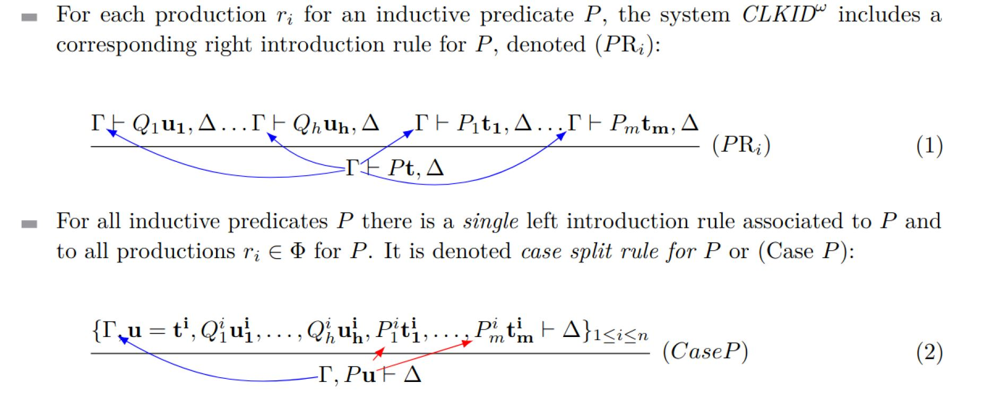
Injective Traces for Sequents as Lists

Slide 8
From Double Exponential to Single Exponential: Merging variables
A large amount of time is required to consider all possible order on variables. Say, induction could be:
On pairs (x,y) with lexicographic order
On pairs (y,x) with lexicographic order
On the lexicographic minimum on (x,y), (y,x).
If we are sure that x and y weakly decrease together we can merge the two variables into one and use induction on
x+y

Slide 9
How Can We Detect Variables Decreasing Together?
GTC condition involves, for some n in N, an infinite tree with edges α→β labeled by bi-colored relations R:α→β on [1,n]x[1,n], with n = maximum number of assumptions N(t) in the antecedent.
A path is any finite or infinite sequence p:
R₁: α₁→α₂, R₂:α₂→α₃, R₃:α₃→α₄, …
In order to merge variables decreasing together in a cyclic proof, we have to study the combinatorial properties of bi-colored relations R on [1,n]x[1,n].

Slide 10
Stable Relations: no dying traces
We say that a relation sequence σ = R₁, R₂, …, R_{n} is stable if and only if dom(R_{i}R_{i+1}) = dom(R_{i}) for all i∈[1,n-1], where: dom(R) = {i | ∃j (i R j)}.
R₁
R₂
R₁
R₂
dying
trace
unstable
stable

Slide 11
Stable Grouping
A grouping of a finite sequence σ = R₁, R₂, R₃, … is any sequence of products
τ = R_{a1}…R_{b1}, R_{a2}…R_{b2}, …
We order groupings of σ according to the number of elements b₁-a₁+1 of the first product, if they are the same according to the to the number of elements b₂-a₂+1 of the second product, and so forth.
For each finite sequence σ = R₁, R₂, R₃, … there is another sequence τ = S₁, …, S_{m} which is a minimum stable grouping of σ = R₁, …, R_{n}.

Slide 12
Grouping in Constant Domain-Cardinality Sequences
Assume S_{c1}, …, S_{d1} is a stable sequence of injective relations. S_{c1}, …, S_{d1} is a constant domain-cardinality sequence when Card(dom(S_{c1}))=…=Card(dom(S_{d1}))
Any stable sequence of injective relations p = S₁, …, S_{m} can be grouped in constant domain-cardinality sequences
q = S_{c1}…S_{d1}, S_{c2}…S_{d2}, S_{c3} …S_{d3}, …
q is stable. All relations in q are injective and the domain cardinalities of S_{c1}…S_{d1}, S_{c2}…S_{d2}, S_{c3} …S_{d3}, … are strictly increasing.

Slide 13
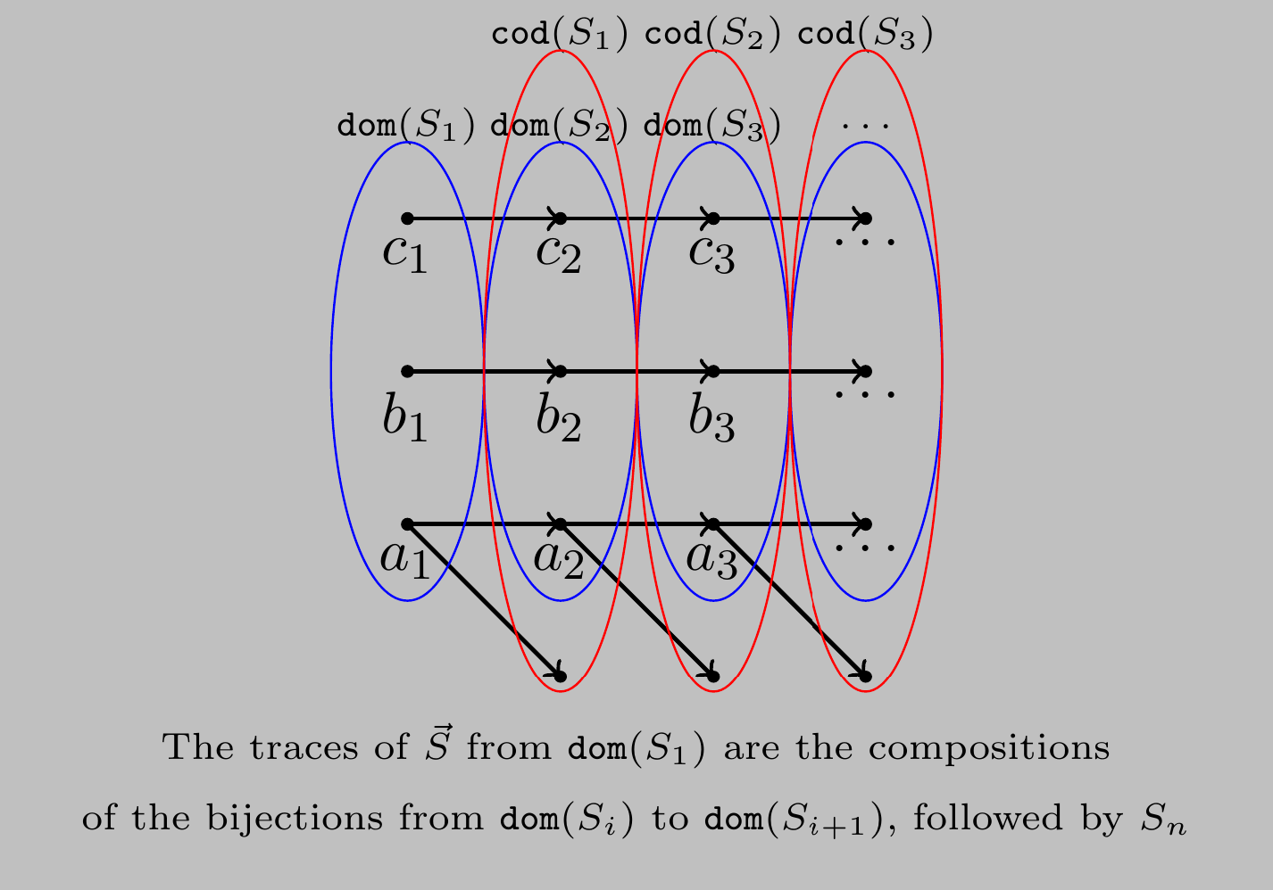
Constant Domain-Cardinality Sequences

Slide 14
An Infinite Progressing Trace Can Have Infinitely Many Stationary steps
The closure of {R:a→a,S:a→a} by composition satisfies GTC, yet the infinite path RSRSRSRS (orange) … has a unique infinite trace in which stationary edges (blue) and progressing edges (red) alternate.
R
S
R
S
R
Infinite trace
a
a
a
a
a
a

Slide 15
How Many Consecutive Stationary Steps? The Stationarity Degree
Assume X,Y⊆[1,n] and R ⊆[1,n]×[1,n] is bi-colored
We say that R is possibly stationary on X→Y if and only if ∀x∈X ∃y∈Y (R stationary on (x,y))
Suppose we have a constant-cardinality injective stable grouping p = S₁, S₂, , …, S_{c}. The stationarity degree d of p is the maximum d<n such that:
S_{i} is possibly stationary on dom(S_{i})→dom(S_{i+1}) for all i∈[c-d+1,c-1]
S_{c} is possibly stationary on dom(S_{c})→range(S_{c})

Slide 16
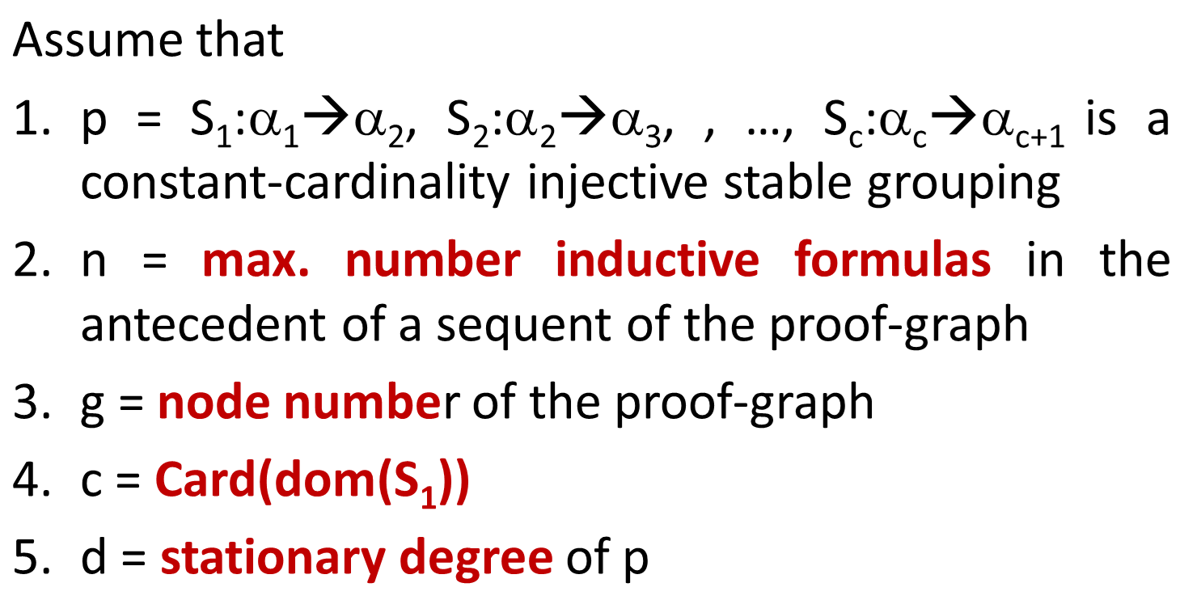

Bound Lemma for Stationarity Degree
If GTC

Slide 17
Merging Variables Together
The size of an inductive formula N(t) is (t+1).
size(p,i) is the size of the i-th inductive formula in the antecedent of the sequent in position p.
For a cyclic proof, there are only finitely many values for S(p,i).
If X⊆[1,n], then we merge size(p,i) for i∈X:
size(p,X) = Σ _{i∈X} size(p,i)
If R⊆[1,n]×[1,n], then we merge size(p,i) for i R j:
size(p,R) = Σ _{i∈dom(R)} max{ size(p,j)|(i R j) }

Slide 18
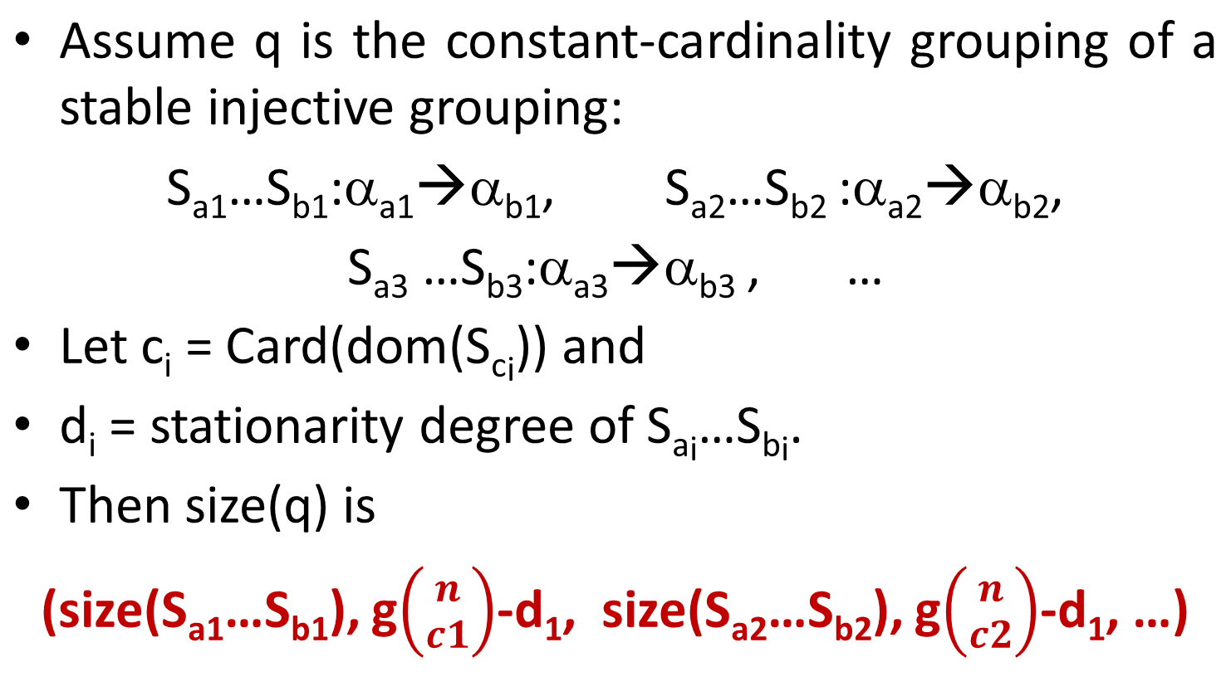
A Ranking Function for a Path
d₂,

Slide 19
A Ranking Function for a Cyclic Proof
Assume a companion has position p in the finite graph whose unfolding is a cyclic proof.
Then we argue by induction on
min{size(p*q)|p*q bud with companion p}
The set of positions p*q which are buds for p are infinite, but the set of sizes size(p*q) is finite.

Slide 20
Thanks to Prof. Makoto Tatsuta …
... for inviting me to the National Institute of Informatics for some 20 years, and to the Software Verification Study Group in Isawa Onsen.
This talk is a joint work with Ugo de’ Liguoro and Daniel Osorio, and it is part of Osorio ph.d..

Slide 21

Isawa Onsen 2024

